Slide 1
LinkedIn
S&P 500
NLP FINAL PROJECT
By Tiziano Paci, Rebecca Solcia and Ashar Qureshi

Slide 2
01. ABOUT THE PROJECT
04. CLASSIFICATION
02. THE DATASET
05. STRUCTURED PREDICTION
03. PRELIMINARY ANALYSIS
06. CONCLUSION
Description of the initial idea and what we planned
Classification task comparing baselines and stronger algorithms
Intuitions behind the scraping process and general statistics
Labelling process and structured prediction algorithms
Topic modelling over two different dimensions
Wrapping up

Slide 3
OUR MAIN GOAL
CLASSIFICATION
Does semi-official communication differ across sectors?
STRUCTURED PREDICTION
Create an event-tagger for LinkedIn to create weekly reports related to different subjects

Slide 4
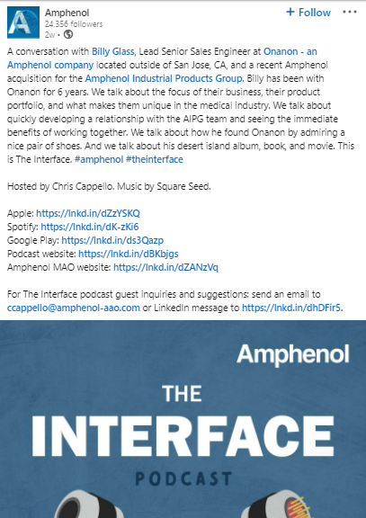
THE DATASET
Sector and capitalization of 480 firms
55,000 LinkedIn posts
Date Posted | Media Type | Post Text | Company | Sector | Tercile
2d ago | Video | I am happ.. | 3M | Industrials | 0
1y ago | Image | We are.. | Intel | Technology | 2
11mo ago | Video | Together.. | Abbott | Healthcare | 1
... | ... | ... | ... | ... | ...

Slide 5
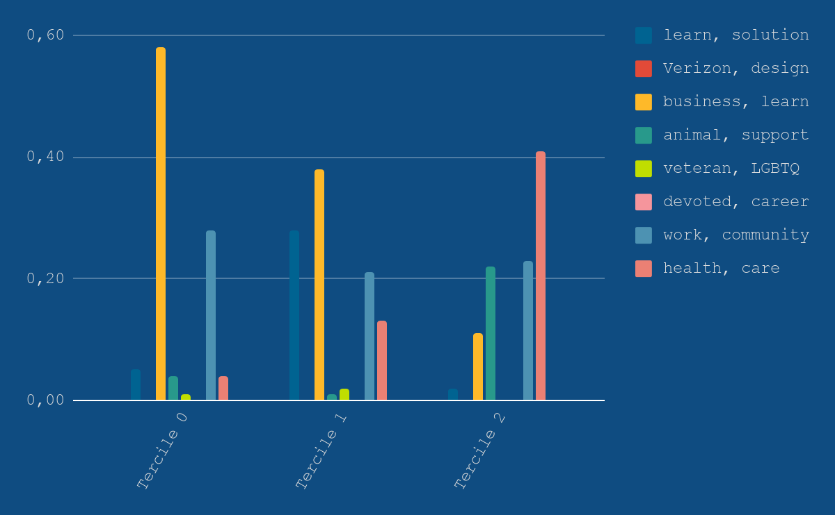
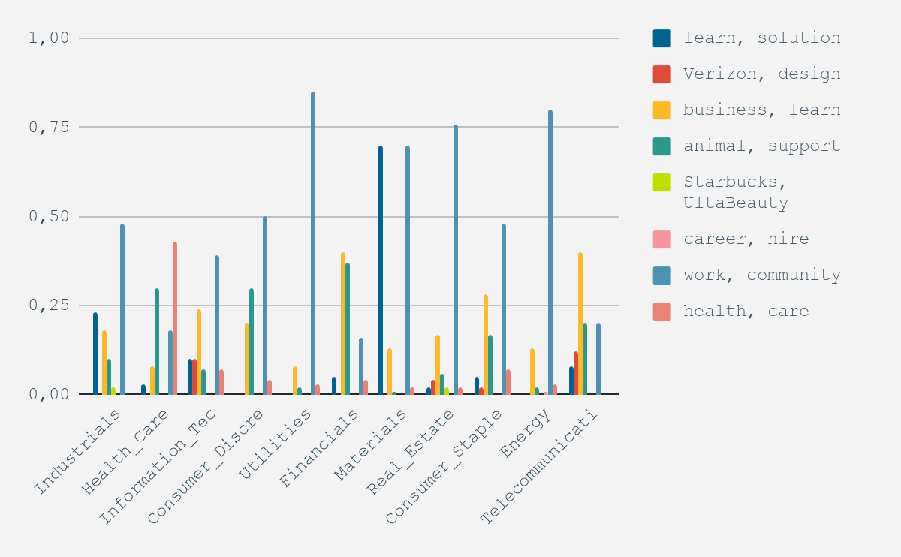
SECTOR TOPIC MODEL
CAPITALIZATION TOPIC MODEL

Slide 6
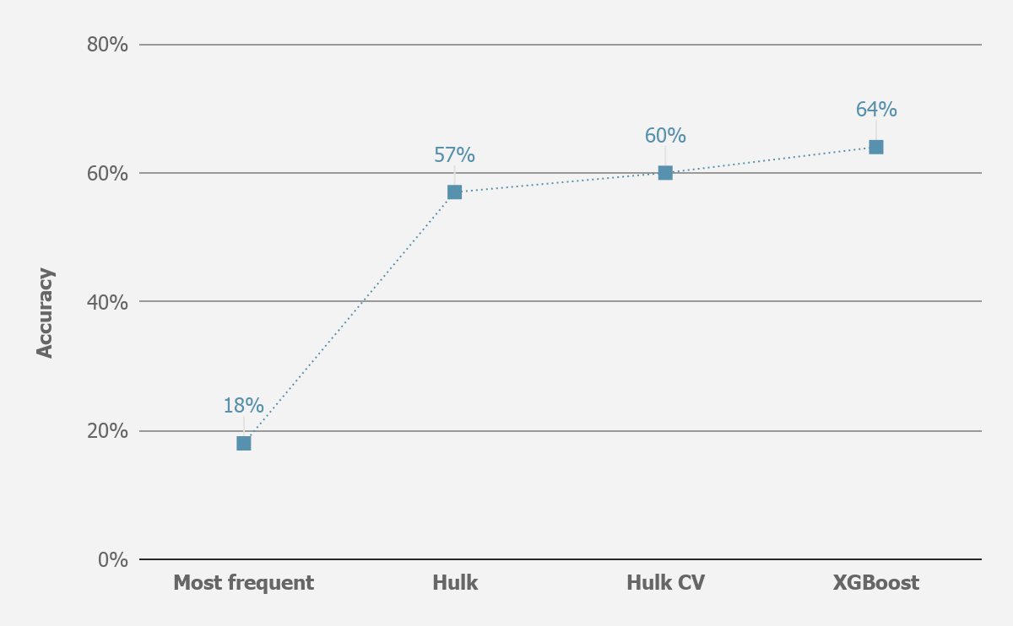
CLASSIFICATION TASK
MOST FREQUENT
THE HULK, CV
First baseline. Most frequent classifier.
Logistic Regression with C = 5 after CV
THE HULK
XGBOOST
Logistic Regression with standard parameters.
Gradient Boosting for multinomial classification

Slide 7
STRUCTURED PREDICTION
Manual labelling of each token (for thousands of posts) to train our event-tagger.
Either “no event” tag, or “topic-specific” event tag.
01
02
03
O No tag
Diversity_Inclusion Women and Minorities
Environment Reusable, zero emission
04
05
06
Financials Revenues, stocks
Innovation New technologies
Social_Impact Donations
Sample post
We’re | bringing | 2500 | Jobs | to | Bellevue | as | part | of | our | investment | in | our | Puget | Sound | plan
O | Social_Impact | O | Social_Impact | O | O | O | O | O | O | O | O | O | O | O | O

Slide 8
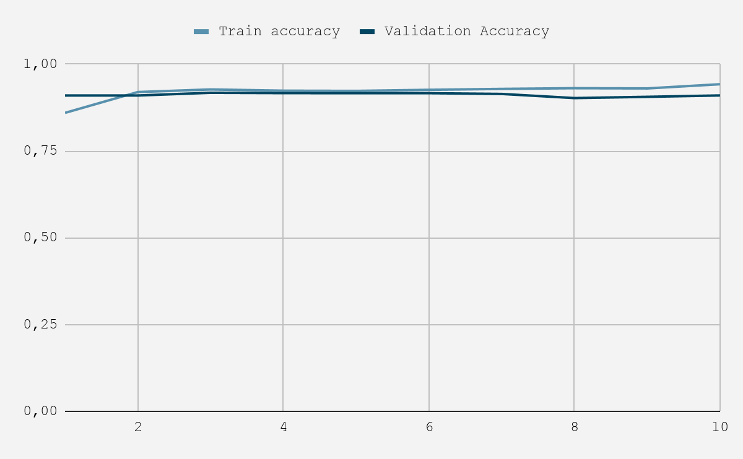
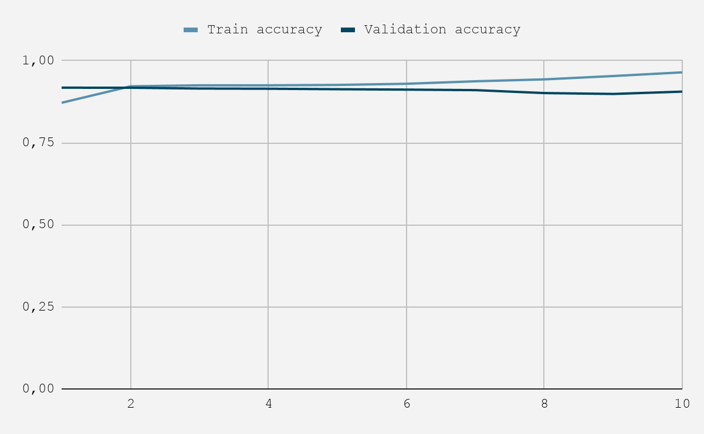
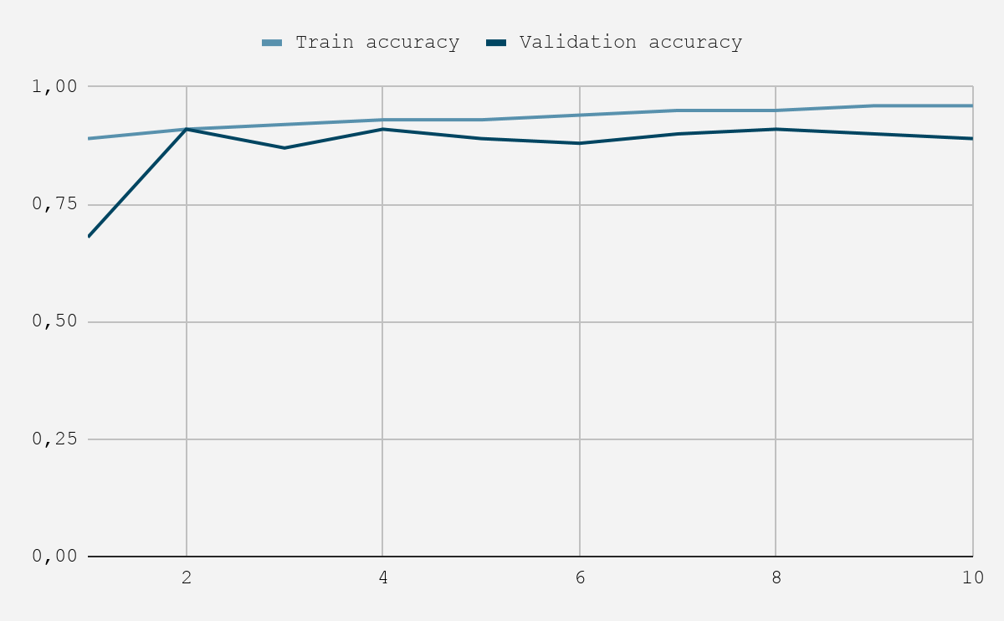
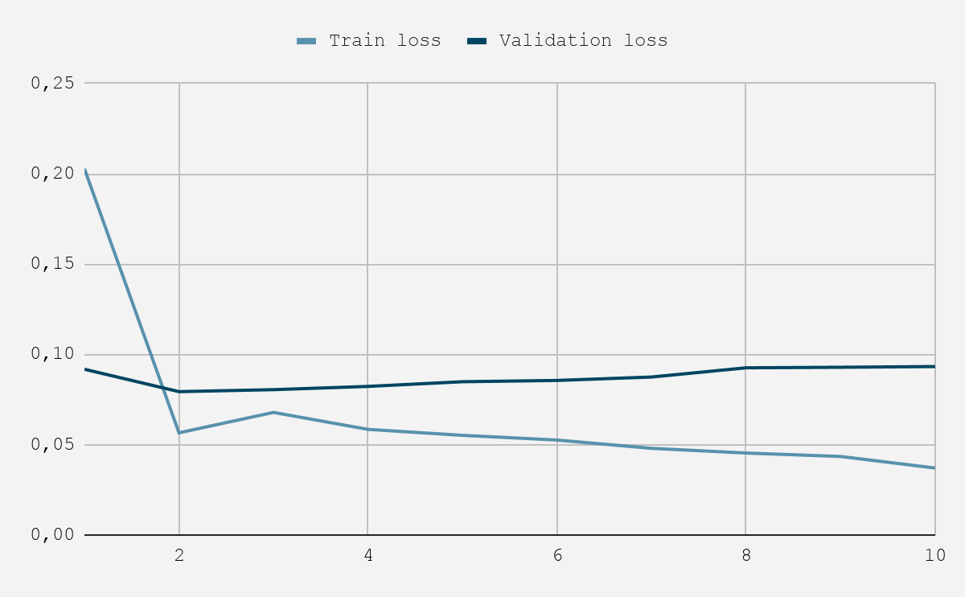
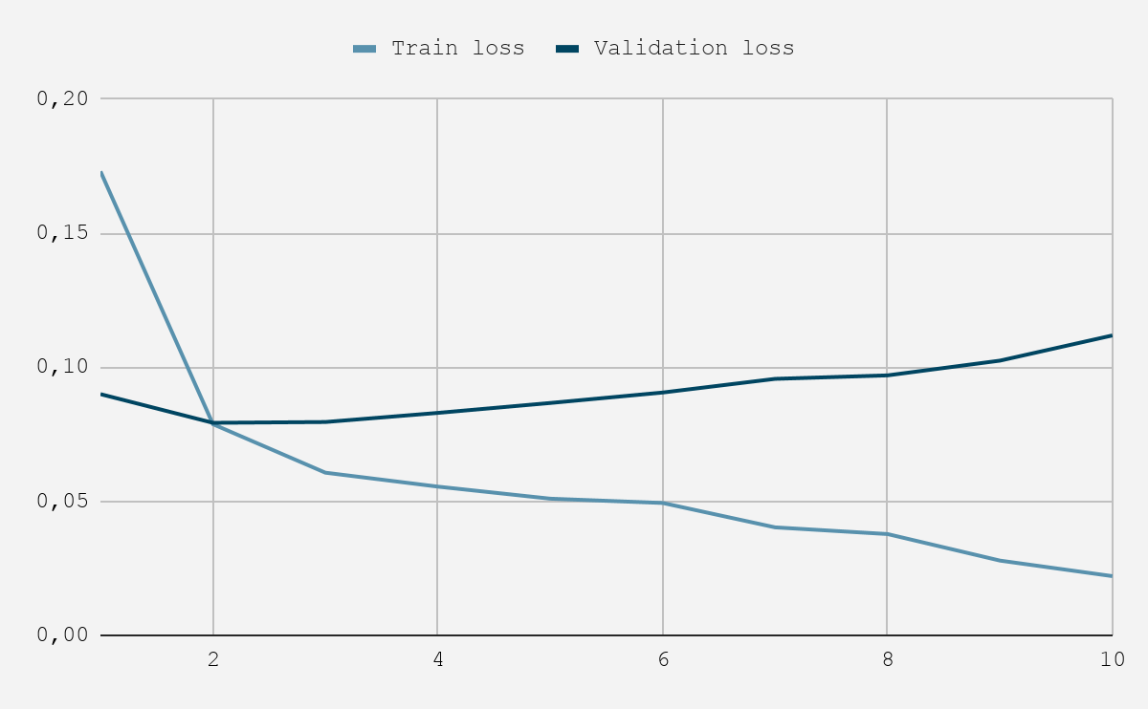
MODELS’ PERFORMANCE
PERCEPTRON
LSTM
BI-LSTM

Slide 9
['Hydrogen’s', 'potential', 'for', 'storing', 'and', 'transporting', 'energy', 'from', 'wind', 'and', 'other', 'renewable', 'sources,', 'makes', 'it', 'a', 'key', 'enabler', 'of', 'a', 'global', 'transition', 'to', 'clean', 'energy', 'and', 'Cummins', 'Inc.', 'is', 'excited', 'to', 'be', 'at', 'the', 'forefront.', 'Take', 'a', 'look', 'at', 'three', 'Cummins', 'installations', 'that', 'use', 'wind', 'energy', 'to', 'generate', 'green', 'hydrogen.']
['O', 'O', 'O', 'O', 'O', 'O', 'O', 'O', 'Environment', 'O', 'O', 'O', 'O', 'O', 'O', 'O', 'O', 'O', 'O', 'O', 'O', 'O', 'O', 'Environment', 'Environment', 'O', 'O', 'O', 'O', 'O', 'O', 'O', 'O', 'O', 'O', 'O', 'O', 'O', 'O', 'O', 'O', 'O', 'O', 'O', 'Environment', 'O', 'O', 'O', 'Environment', 'O']
STRUCTURED PERCEPTRON
['O', 'O', 'O', 'O', 'O', 'O', 'O', 'O', 'Financials', 'O', 'O', 'Environment', 'Financials', 'O', 'O', 'O', 'O', 'O', 'O', 'O', 'O', 'O', 'O', 'Environment', 'Environment', 'O', 'O', 'O', 'O', 'O', 'O', 'O', 'O', 'O', 'O', 'O', 'O', 'O', 'O', 'O', 'O', 'O', 'O', 'O', 'O', 'O', 'O', 'O', 'O', 'O']
LSTM
Bi-LSTM
['O', 'O', 'O', 'O', 'O', 'O', 'O', 'O', 'Financials', 'O', 'O', 'Environment', 'Financials', 'O', 'O', 'O', 'O', 'O', 'O', 'O', 'O', 'O', 'O', 'Environment', 'Environment', 'O', 'O', 'O', 'O', 'O', 'O', 'O', 'O', 'O', 'O', 'O', 'O', 'O', 'O', 'O', 'O', 'O', 'O', 'O', 'O', 'O', 'O', 'O', 'O', 'O']

Slide 10
THANKS!
Do you have any questions?
Feel free to contact us!
tiziano.paci@studbocconi.it
rebecca.solcia@studbocconi.it
ashar.qureshi@studbocconi.it

